Slide 1
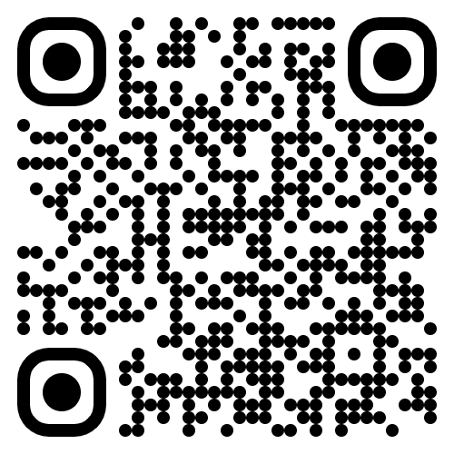

Intro Meeting
September 4th, 2025

Slide 2
Agenda
Executive Board Introductions
AIG Expectations
Overview of Asset Classes
Leadership and Engagement Opportunities
Events Timeline
Paid Membership
Q+A Period
Notes:
Agenda /sign in QR code

Slide 3
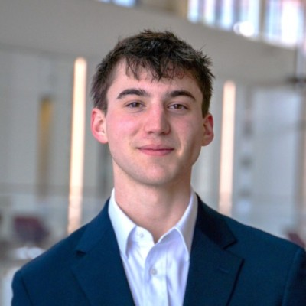
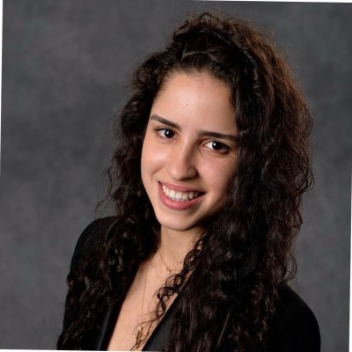
Executive Board Introductions
Matt Walper
E-Board
Matt is a Junior, majoring in Finance with a minor in Real Estate, who interned at Rockbridge Growth Equity this past summer
On campus, Matt is involved in FMI, FA, GWF, and IM football/basketball/volleyball
Next summer, Matt will be at Stout as an Investment Banking Summer Analyst in their Chicago office
Lilia Laraki
E-Board
Lilia is a Junior, double majoring in Finance and Economics with a minor in data analytics, who previously interned at Attijariwafa Bank Europe
On campus, Lilia is involved in STG, a TA for FI 491, and is one of the co-founder of WF
Next summer, Lilia will be at Goldman Sachs within their Sales and Trading Division in New York City

Slide 4
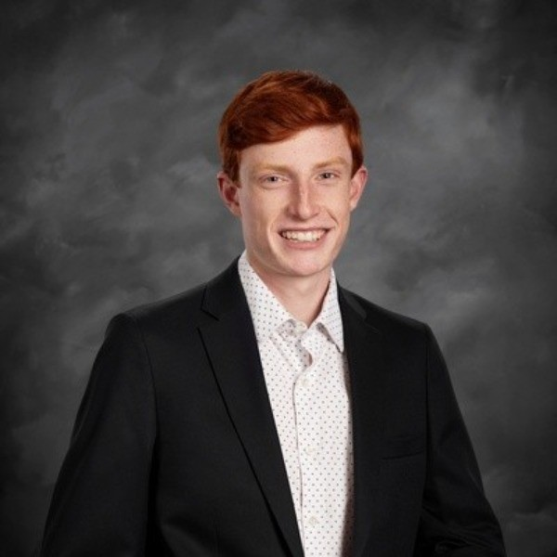
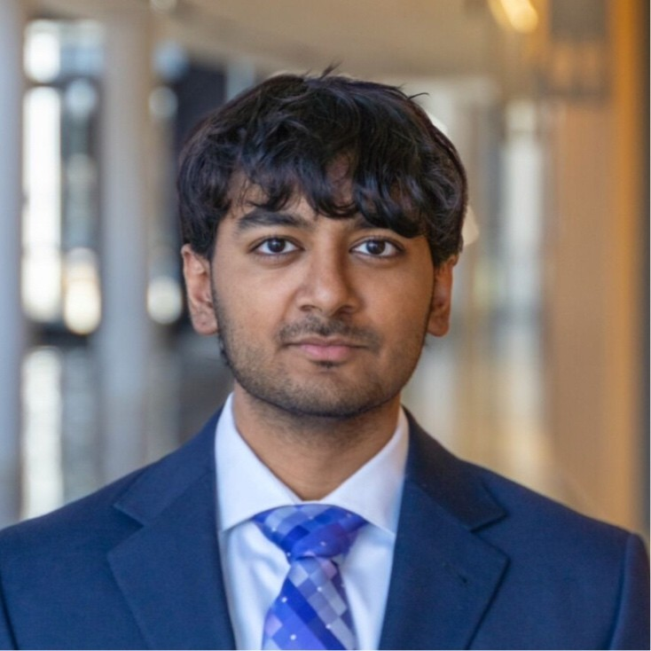
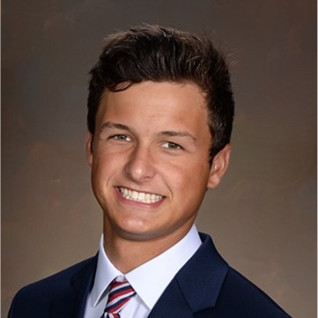
Executive Board Introductions
Adam Robinson
E-Board
Adam is a junior, double majoring in Finance and Biochemistry, who previously interned at Resurgens Technology Partners and Cascade Partners
On campus, Adam is involved in FMI, PE@Broad, MSU Burgess Institute for Entrepreneurship & Innovation, Waterski Club, and IM Soccer
Next summer, Adam will be at Houlihan Lokey as a Healthcare Investment Banking Summer Analyst in their Chicago office
Sid Akkala
E-Board
Sid is a junior, double majoring in Finance and Economics with a minor in CMSE. He previously interned at the investment bank SellSide Group and has venture capital experience at Exit Quotient Ventures
On campus, Sid is involved with FMI, Broad Student Senate, and MRG
Next summer, Sid hopes to work in private equity Secondaries

Slide 5
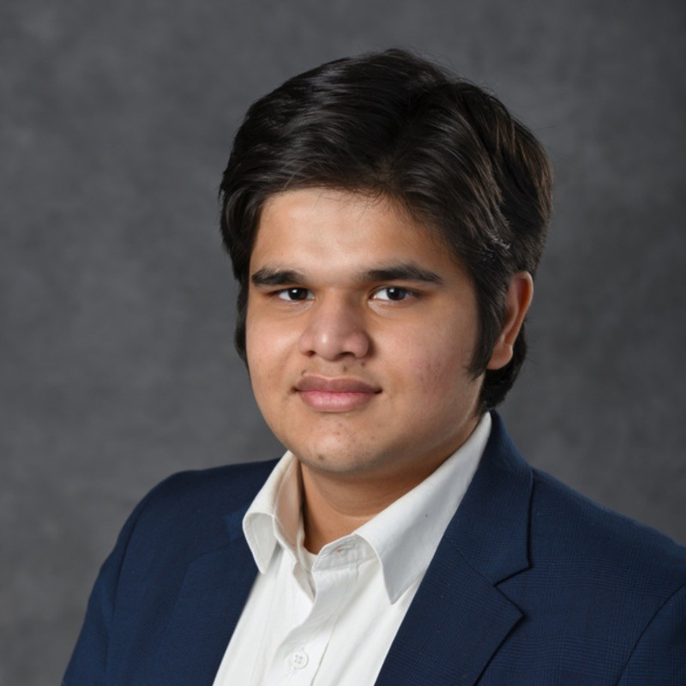
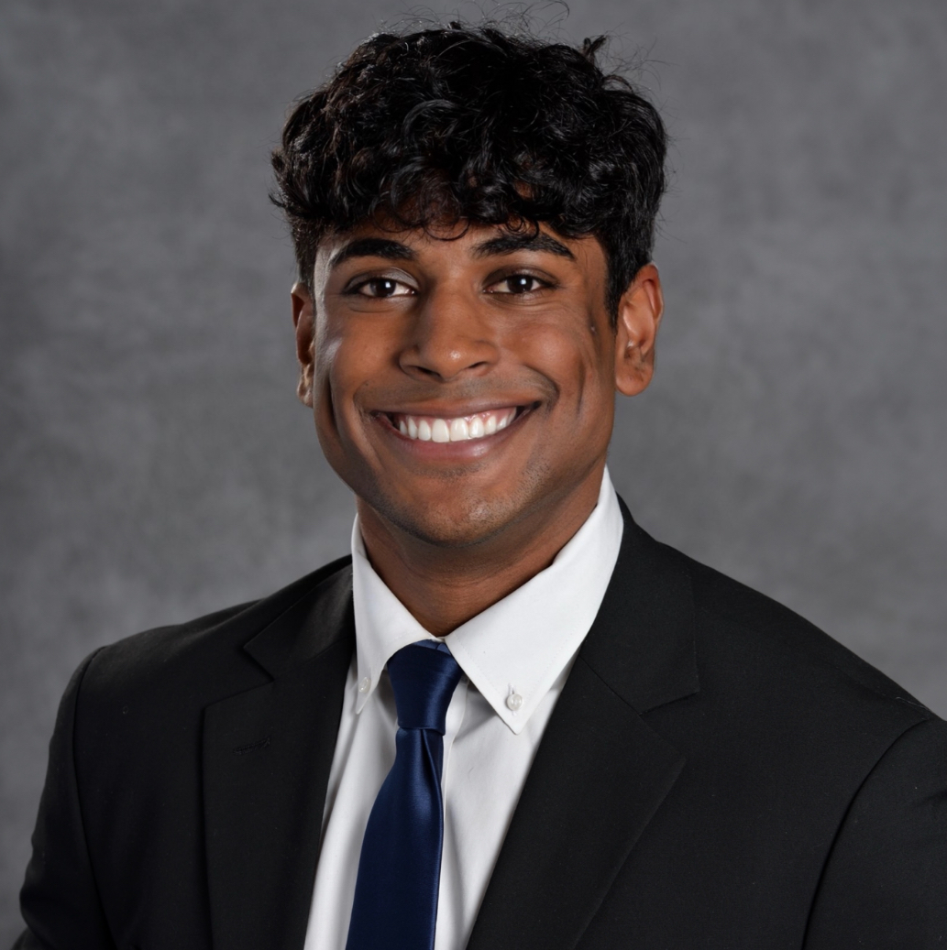
Executive Board Introductions
Parth Tiwari
E-Board
Parth is a Junior, double majoring in Finance and Economics, who previously interned with Michigan Rise, Ambit Private Limited, and Brightside Legacy
On campus, Parth is involved with FMI, GWF, and PE@Broad
Next summer, Parth hopes to work in investment banking
Sid Akkala
E-Board
Sid is a junior, double majoring in Finance and Economics with a minor in CMSE. He previously interned at the investment bank SellSide Group and has venture capital experience at Exit Quotient Ventures
On campus, Sid is involved with FMI, Broad Student Senate, and MRG
Next summer, Sid hopes to work in private equity Secondaries

Slide 6
AIG Expectations
Meetings: Thursdays 5-6 PM in Room M235
Attendance: weekly attendance is required for all sector head and analyst positions – Must reach out 24 hours in advance of meeting if unable to attend.
Dress Code: Business Casual.
Educational Series: Sector head and analyst groups will lead a presentation session with an overview of their specific asset class.
Guest Speakers: Industry professionals from various asset classes will share their insights as guest speakers.
Professional Development: resume workshops, case studies, and technical study sessions.
Social Events: host social events to strengthen our community.
Notes:
Jack

Slide 7






Asset Classes Covered
Alternative investments are competitive investment strategies that are not open to the public and require a large pool of private capital
Private Equity
Investments in private companies, or buyouts of public companies, resulting in the delisting of the public company.
Hedge Funds
Investment partnership between a hedge fund manager and investors that pool their money together into a fund to maximize returns and mitigate risk.
Venture Capital
Investments in generally high-risk/high-reward startup companies and small businesses.
Private Credit
Non-bank corporate loans that are high-yielding illiquid investments, offered to businesses that are unable to secure financing from traditional bank lenders.
Real Estate
Investments in real estate properties that generate income for investment purposes rather than a primary residence.
Secondaries
Institutional investors who buy existing private equity stakes from current investors for access to mature assets, allowing current limited partners access to liquidity.
Notes:
Dina

Slide 8
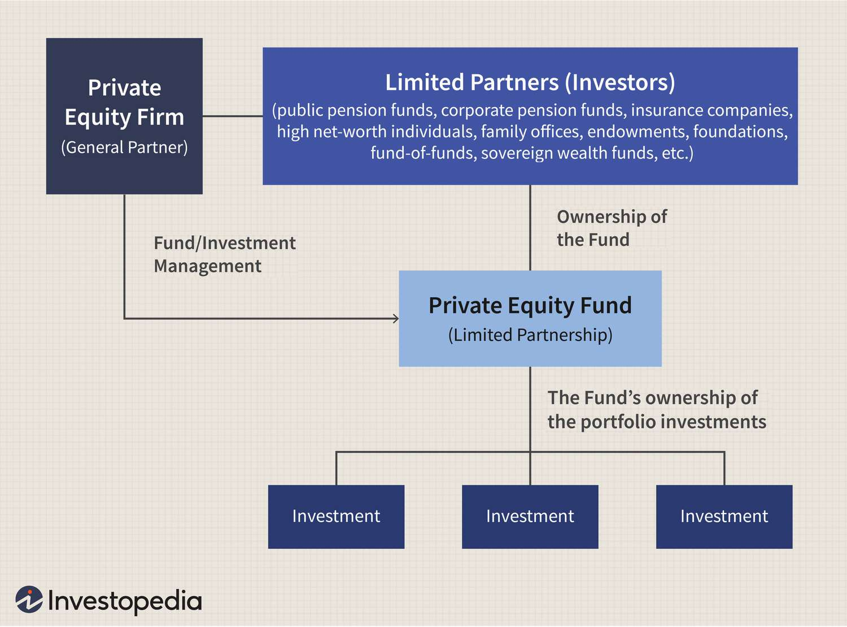






Private Equity Overview
investing in companies to grow and improve them
Private Equity Funds
Private Equity is an alternative investment class that raises capital from limited and general partners to deploy investments in companies.
Funds will manage companies and work to improve profits margins and pay down debt to increase their equity in the portfolio company.
In the buyout of companies, the PE group will often utilize leverage (debt) to amply their returns and return a larger profit to their partners.
Leveraged Buyouts (LBO)
Notes:
Jack

Slide 9





Hedge Fund Overview
High risk-adjusted returns in the public markets
Hedge Funds
Alternative investment funds that raise capital from institutional investors to deploy in securities or other assets across a vast range of markets.
The objective is to produce positive, satisfactory returns for both investors and managers.
How do they achieve their goals?
Utilize a handful of trading techniques and instruments (e.g.: options, shorts, etc.).
Heavy technical security analysis and heavy emphasis on timed moves.
Common strategies include global macro trends, long / short, event driven, and others.
Notes:
Luke

Slide 10









Venture Capital Overview
funding for businesses poised for strong future growth
Venture capital
How do they achieve their goals?
A form of private equity that funds startups and early-stage companies with long-term growth potential.
Types of Venture Capital include pre-seed, seed funding, and early-stage funding.
Take an ownership stake or an active interest in the companies in return for funding.
Their goal is to increase the value of the company, then exit investment by either selling the fund's stake or via an IPO.
Investors
$$$
VC Fund
$$$
Portfolio
Pension Funds
Capital
Invest
Notes:
Saransh

Slide 11
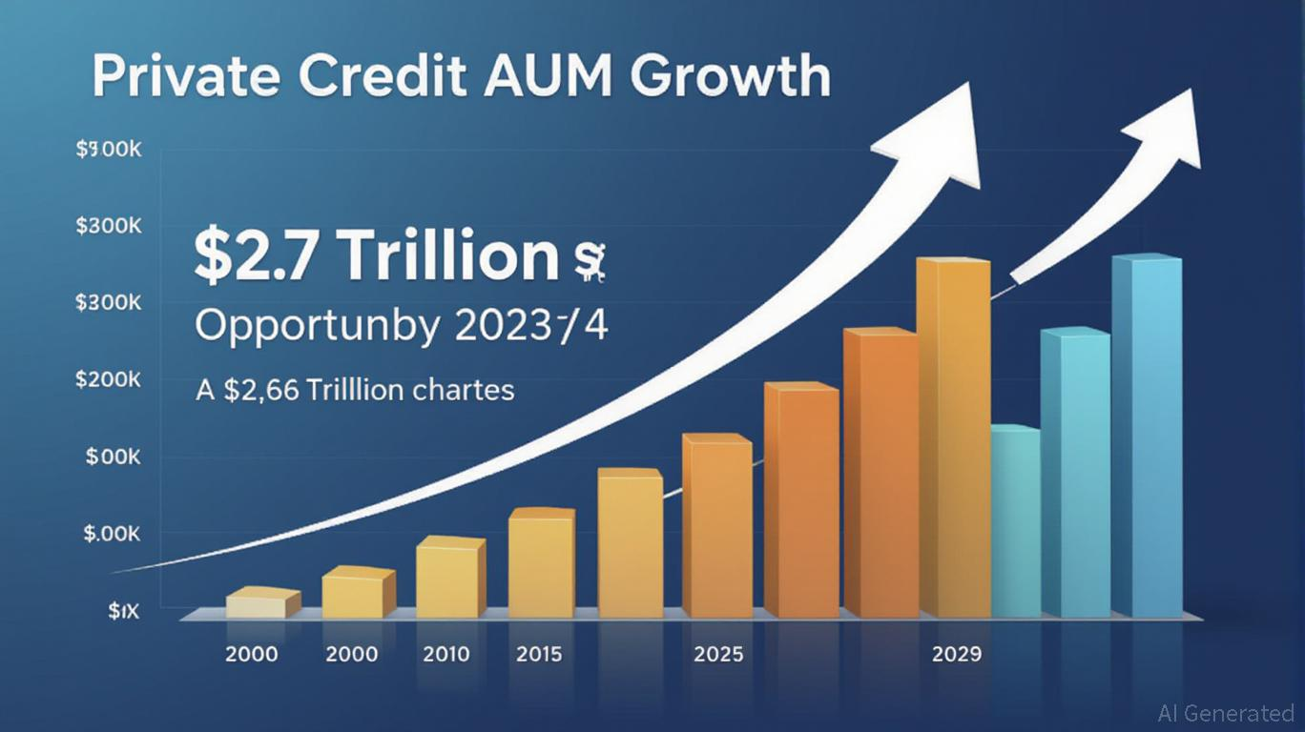
Private Credit Overview
Non-Bank Lending
Private Credit Funds
Private Credit refers to non-bank lending to a privately held company.
These corporate loans are high yielding illiquid investments.
Investor lends money to the company in exchange for interest payments.
Also known as “Direct Lending” or “Private Lending”.
Who do they lend to?
Lending money to companies that are too small to raise money through corporate bonds and unable to get loans from banks.
Companies willing to pay higher interest rate to get money faster and have more flexibility.
Loans to companies that do not have typical needs or good credit ratings.
Notes:
Dina

Slide 12


Real Estate Overview
buying, managing, or developing properties to generate income
Real Easte
Investments in real estate properties that generate income for investment purposes rather than as a primary residence.
Investment groups includes institutional REITs and Private Equity Real Estate firms.
How do they Achieve a return?
Real estate firms often employ a combination of strategies to maximize their returns while managing risk in the dynamic real estate market.
Returns are generated by rental income asset appreciation, and building equity.
Notes:
Yash

Slide 13
Secondaries Overview
Providing liquidity to current investors, gaining access to mature assets
LP-Led Secondaries
GP-Led Secondaries
In a LP-led transaction, a limited partner sells its commitment in a fund to a secondary buyer, who then takes on the rights and obligations of that LP in the existing fund.
In a GP-led transaction, specifically a GP-led single-asset continuation transaction, an asset or portfolio company is transferred from one vehicle to another vehicle, which can offer access to both additional capital and additional time to execute a value-creation plan.
New Investors
$$$
Current Investors
New Investors have ownership in current portfolio companies
Capital
institutional Funds
institutional Funds
Notes:
Jack

Slide 14
AIG Roles
Leadership and Engagement Opportunities
Sector Head Overview
Sector Analyst Overview
Lead a team of 3-4 analysts to build and present educational materials.
Interact with E-Board to shell out decks and produce new ideas.
Act as point of contact for other AIG members looking to learn more about careers and opportunities in your sector.
Maintains relationships with industry professionals and guest speakers.
Reviews and approves sector reports and presentations.
Work alongside a sector head to build PowerPoint presentations and other educational materials.
Conducts detailed company and market research within sector.
Monitors industry trends and news for actionable insights.
Collaborates with fellow analysts to produce comprehensive sector coverage.
Engages with guest speakers and incorporates insights into analysis.
Notes:
Jack

Slide 15
Timeline - Fall
Key
Events
Speakers
Sector Heads
Analyst
General
September
October
November
December
Week 1
Sep-4
Week 2
Sep-11
Week 3
Sep-18
Week 4
Sep-25
Week 5
Oct-2
Week 6
Oct-9
Week 7
Oct-16
Week 8
Oct-23
Week 9
Oct-30
Week 10
Nov-6
Week 11
Nov-13
Week 12
Nov-20
Week 13
Nov-27
Week 14
Dec-4
Week 15
Dec-11
Interviews
Sector Heads
Analysts
Weekly Breakdown
Weekly Meetings
Kickoff
Sell Side vs Buy Side
Interview Workshop
Resume Workshop
Welcome: New Positions
Asking Good Questions
PE Presentation
Hayride
Senior Panel
Secondaries Presentation
Speaker Series
VC Presentation
No Meeting:
Thanksgiving
Holiday Party
No Meeting:
Finals
Interview Expectations
Where / How to Recruit
Coffee Chats
Interactive Activity
Interactive Activity
Interactive Activity
To-Do
PE Deck Outline
PE Deck Creation
Secondaries Deck Outline
Secondaries Deck Creation
VC Deck Outline
VC Deck Creation
Thank You Notes
Turn Deck Comments
Turn Deck Comments
Turn Deck Comments
Agenda subject to change

Slide 16
Timeline - Spring
Key
Events
Speakers
Sector Heads
Analyst
General
January
February
March
April
Week 1
Jan-22
Week 2
Jan-29
Week 3
Feb-5
Week 4
Feb-12
Week 5
Feb-19
Week 6
Feb-26
Week 7
Mar-5
Week 8
Mar-12
Week 9
Mar-19
Week 10
Mar-26
Week 11
Apr-2
Week 12
Apr-9
Week 13
Apr-16
Week 14
Apr-23
Week 15
Apr-30
E-Board Interviews
Weekly Breakdown
Weekly Meetings
Market Mapping
Recruiting Overview
Real Estate Presentation
Analysis: CIP/Financials
Speaker Series
Paper LBO
Road Show:
New York City
Hedge funds Presentation
Social
Credit
Presentation
Spring Break
Speaker Series
New E-Board Intros
No Meeting:
Study for Finals
No Meeting:
Finals
Interactive Activity
Interactive Activity
Jeopardy
To-Do
RE Deck Outline
RE Deck Creation
Thank You Notes
HF Deck Creation
PC Deck Outline
PC Deck Creation
Thank You Notes
Turn Deck Comments
HF Deck Outline
Turn Deck Comments
Turn Deck Comments
Agenda subject to change

Slide 17
Upcoming Events
Sector Head Application Deadline
Applications Due Monday 9/9 at 11:59pm
Sector Analyst Application Deadline
Applications Due Monday 9/23 at 11:59pm
Senior Student Panel
Thursday 9/19, 5:00pm – 6:00pm, in Room M200
FMI DE&I Panel
Thursday 9/26, 3:30pm – 5:00pm, Multipurpose Room
Buy-side vs. Sell-side overview
Thursday 9/26, 5:00pm – 6:00pm, in Room M200
Hayride With SIA and FA
Thursday 10/24, Andy T’s - details forthcoming
Notes:
Dina

Slide 18

Paid Membership
Membership Benefits
Pricing Options
Access to exclusive slide decks and resources available on AIG website.
Member only Private Equity case study.
Future leadership application eligibility (Sector Analyst/Lead, Executive Board ).
Social events including Hayride, holiday parties, and NYC Roadshow
$40 for one Semester
$65 for One Year
How to become a paid member
Dues can be paid directly using the QR code provided to the right. Please submit your payment at your earliest convenience. If you have any questions or concerns, reach out to Matt at walperma@msu.edu
Notes:
Yash

Slide 19
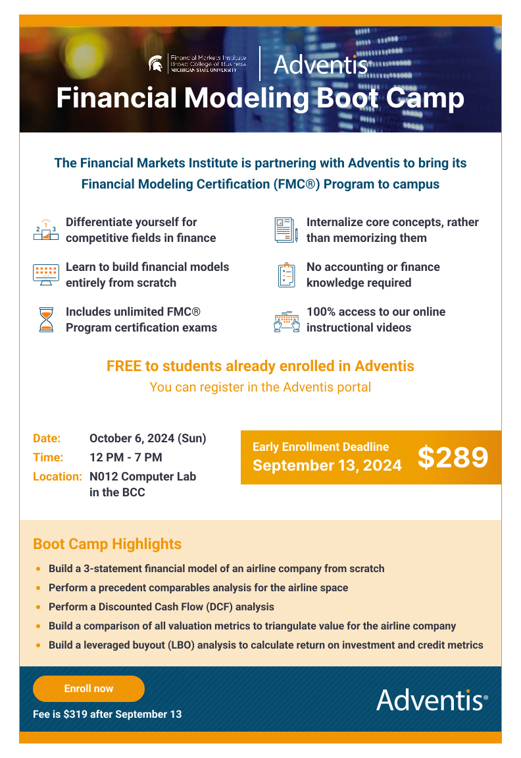
Adventis Financial Modeling Boot Camp
Notes:
Jack

Slide 20
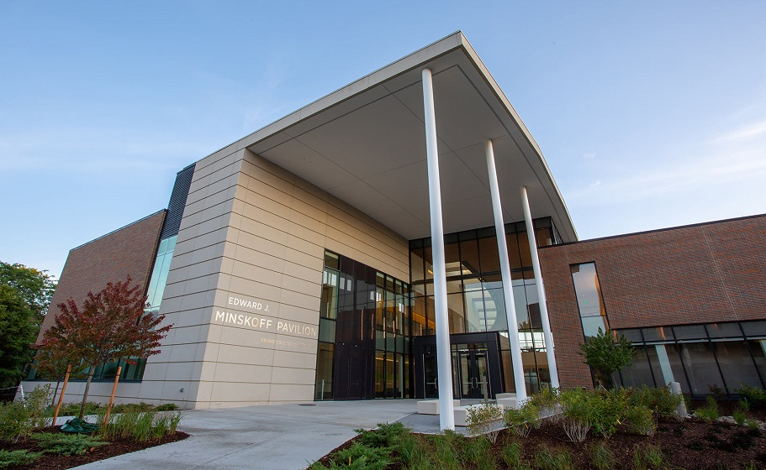

Q&A Period
Dina Younes
President
walperma@msu.edu
Lilia Laraki
Vice President
larakili@msu.edu
Sid Akkala
Treasurer
akkalasi@msu.edu
Adam Robinson
Head of Business Development
robi1367@msu.edu
Parth Tiwari
Director of Education
tiwaripa@msu.edu
Alternative Investments Group
aigmsu@gmail.com
@aig_msu

Slide 21
QR Codes
Attendance
Pay Dues

